Slide 1

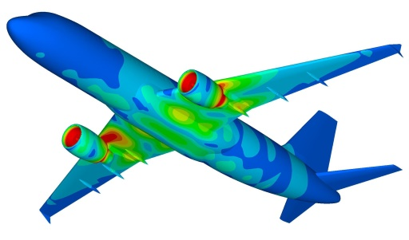
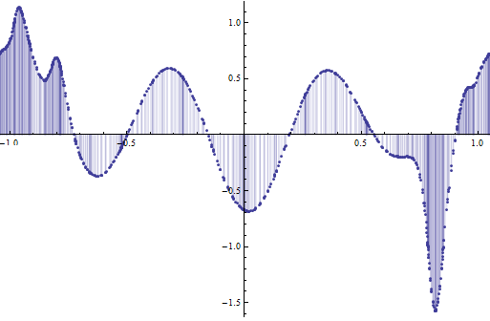
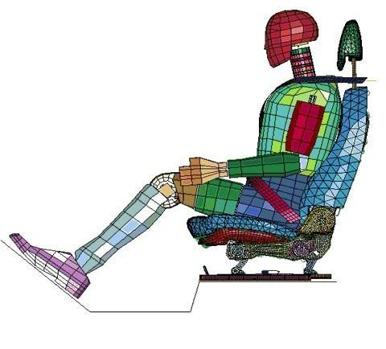
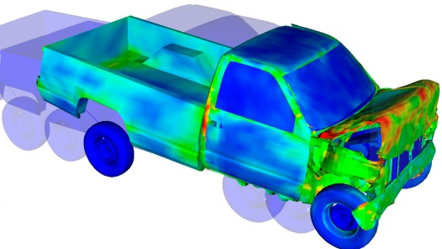
Numerical Integration
Dr. Himanshu Pathak
himanshu@iitmandi.ac.in

Slide 2
Numerical Integration
Evaluate the integral, without doing the calculation analytically.
In essence, Integrand is too complicated to integrate analytically.
f(x)
where
sum of height × width
Δx
Integration is a summing process. Thus virtually all numerical approximations can be represented by
w_{i} are the weights, x_{i} are the sampling points, and E_{t} is the truncation error.

Slide 3

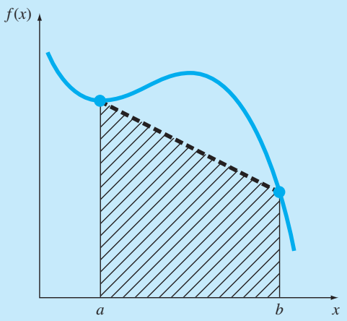
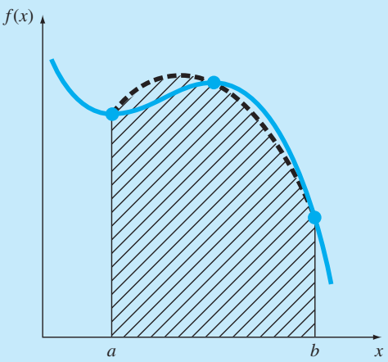
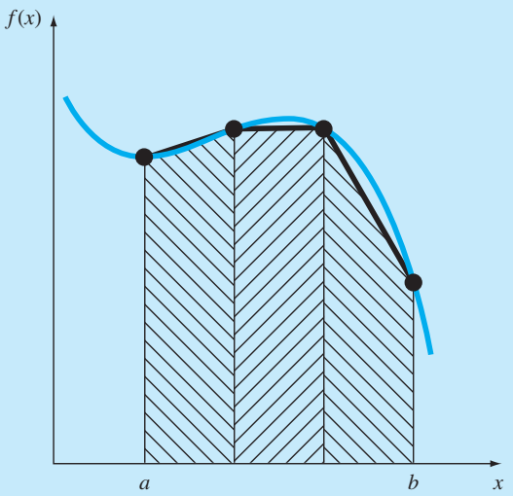
Newton-Cotes Integration
Newton-Cotes formulas are the most common numerical integration schemes.
It replaces a complicated function with an approximating function that is easy to integrate numerically.
By Newton-Cotes formulas
1st order Polynomial
2nd order Polynomial
1st order Polynomial segment wise

Slide 4


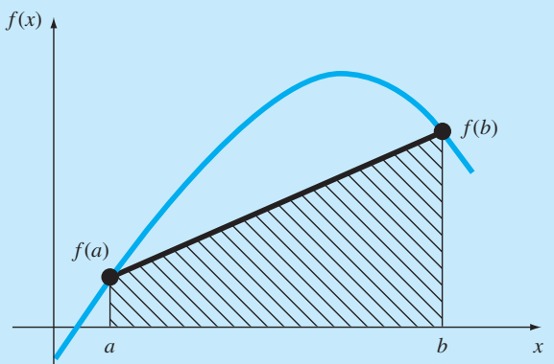

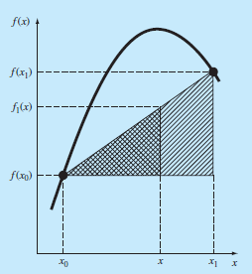

Trapezoidal Rule
The trapezoidal rule is the first order example of the Newton-Cotes closed integration formulas.
Trapezoidal Rule
Using linear interpolation

Slide 5



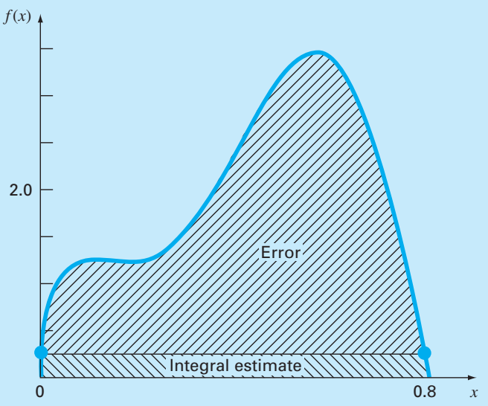
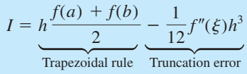

Trapezoidal Rule
Trapezoidal Rule

Slide 6



Trapezoidal Rule
Example: Numerically integrate the following polynomial
f(x)= 0.2 + 25x - 200x² + 675x³ - 900x⁴ + 400x⁵ from a = 0 to b = 0.8.
The exact value of the integral can be determined analytically to be 1.640533.
Trapezoidal Rule
Integral
Turncation Error

Slide 7

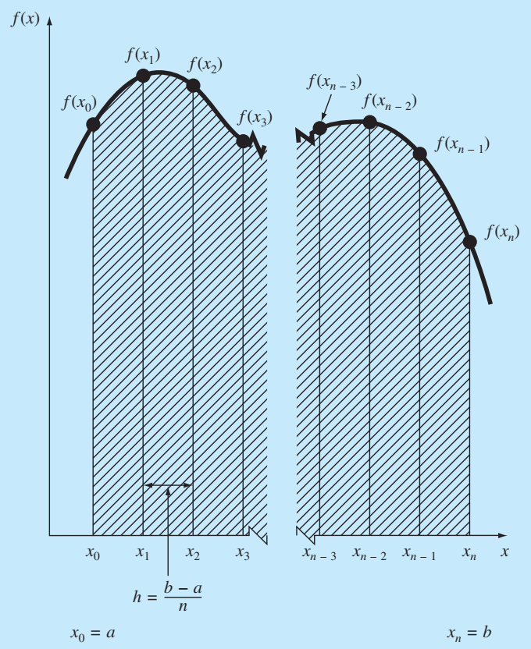


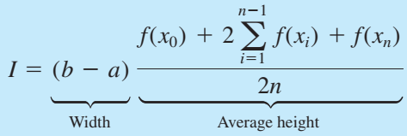

Multiple-Application Trapezoidal Rule
One way to improve the accuracy of the trapezoidal rule is to divide the integration interval from a to b into a number of segments and apply the method to each segment.
The areas of individual segments can then be added to yield the integral for the entire interval.
The resulting equations are called multiple-application, or composite, integration formulas.
n + 1 equally spaced base points (x0, x1, x2, . . . , xn).
n segments of equal width
Segment Width
Total Integrals

Slide 8
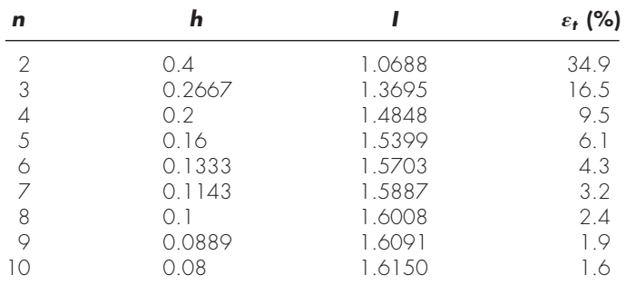
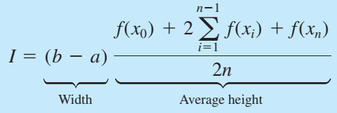

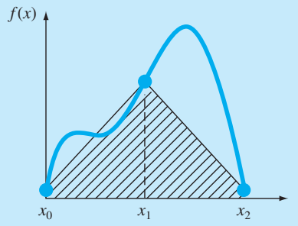
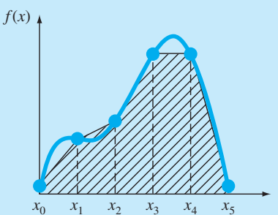
Multiple-Application Trapezoidal Rule
Example: Numerically integrate the following polynomial
f(x)= 0.2 + 25x - 200x² + 675x³ - 900x⁴ + 400x⁵ from a = 0 to b = 0.8.
The exact value of the integral can be determined analytically to be 1.640533.
Multiple-Application Trapezoidal Rule
Integral
Turncation Error
2 segments
5 segments

Slide 9
MATLAB© Script
MATLAB Program for Multiple-Application Trapezoidal Rule
clear all
clc
a= 0; % lower limit
b = 0.8; % upper limit
c = 10; % No of segments
x=linspace(a,b,c+1); % point generation
n=length(x);
h = (b-a)/(n-1);
sum= 0;
for i=2:n
X1 = int_fun(x(i-1));
X2 = int_fun(x(i));
sum = sum + h*((X1 + X2)/2);
end
sum

Slide 10
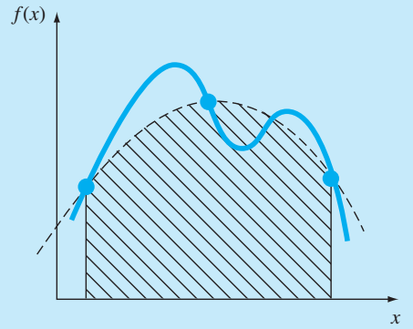
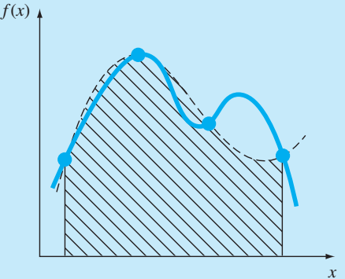
Simpson’s Rule
One way to improve the accuracy of the trapezoidal rule is to use higher order polynomial in function approximation.
As compared with Trapezoidal rule (function is approximated by first order polynomial); Simpson’s 1/3 rule use second-order Lagrange polynomial for each integrant segment.
Simpson’s 3/8 rule use third-order Lagrange polynomial for each integrant segment.
2nd order (Simpson’s 1/3)
3rd order (Simpson’s 3/8)

Slide 11

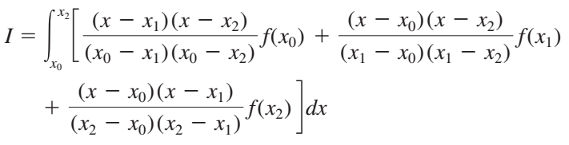

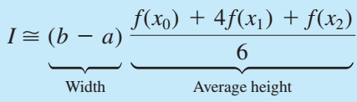

Simpson’s 1/3 Rule
A second-order interpolating polynomial is substituted the integrant.
Simpson’s 1/3 Rule
If a and b are designated as x₀ and x₂ and f₂(x) is represented by a second-order Lagrange polynomial.

Slide 12

Simpson’s 1/3 Rule
Example: Numerically integrate the following polynomial
f(x)= 0.2 + 25x - 200x² + 675x³ - 900x⁴ + 400x⁵ from a = 0 to b = 0.8.
The exact value of the integral can be determined analytically to be 1.640533.
Simpson’s 1/3 Rule
Integral
Truncation Error
Approximately 5 times more accurate than for a single application of the Trapezoidal rule

Slide 13
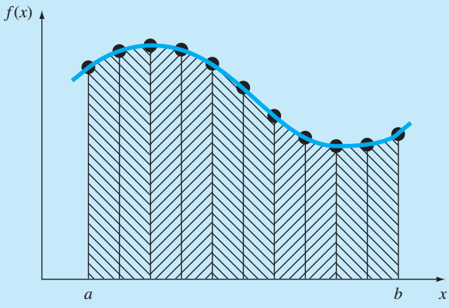
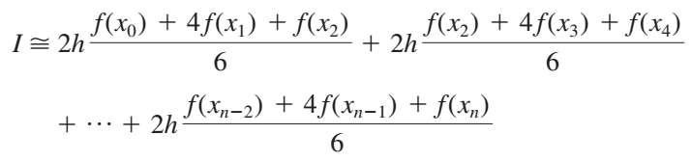
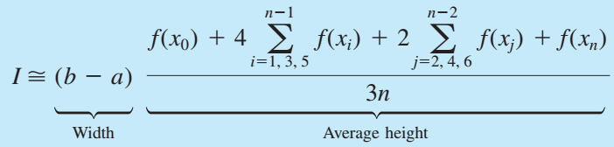

Multiple-Application Simpson’s 1/3 Rule
One way to improve the accuracy of the Simpson’s 1/3 Rule is to divide the integration interval from a to b into a number of segments and apply the method to each segment.
The areas of individual segments can then be added to yield the integral for the entire interval.
n + 1 equally spaced base points (x0, x1, x2, . . . , xn).
n segments of equal width
Segment Width
Total Integrals

Slide 14
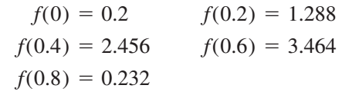
Multiple-Application Simpson’s 1/3 Rule
Example: Numerically integrate the following polynomial
f(x)= 0.2 + 25x - 200x² + 675x³ - 900x⁴ + 400x⁵ from a = 0 to b = 0.8.
The exact value of the integral can be determined analytically to be 1.640533.
Multiple-Application Simpson’s 1/3 Rule
Integral
Truncation Error

Slide 15

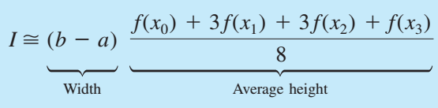

Simpson’s 3/8 Rule
A third order Lagrange polynomial can be fit to four points and integrated.
Simpson’s 3/8 Rule
Here, f₃(x) is represented by a third-order Lagrange polynomial.

Slide 16

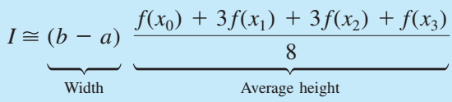
Simpson’s 3/8 Rule
Example: Numerically integrate the following polynomial
f(x)= 0.2 + 25x - 200x² + 675x³ - 900x⁴ + 400x⁵ from a = 0 to b = 0.8.
(a) Use Simpson’s 3/8 rule (b) Use Simpson’s 1/3 and Simpson’s 3/8 for total 5 segments
(a) Simpson’s 3/8 Rule
Requires four equally spaced points
Integral
Truncation Error

Slide 17
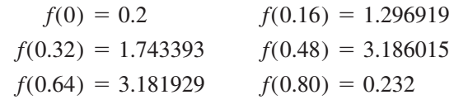


Simpson’s 3/8 Rule
Example: Numerically integrate the following polynomial
f(x)= 0.2 + 25x - 200x² + 675x³ - 900x⁴ + 400x⁵ from a = 0 to b = 0.8.
(a) Use Simpson’s 3/8 rule (b) Use Simpson’s 1/3 and Simpson’s 3/8 for total 5 segments
(b) Simpson’s 1/3 and Simpson’s 3/8
Requires atleast 6 equally spaced points or 5 segments
Integral for the first two segments is obtained using Simpson’s 1/3 rule
Integral for the last three segments is obtained using Simpson’s 3/8 rule
Total Integral
Truncation Error

Slide 18
MATLAB© Script
MATLAB Program for Simpson’s 1/3 Rule
clear all
clc
a= 0; % lower limit
b = 0.8; % upper limit
x=linspace(a,b,3);
y = int_fun(x);
Integral = (b-a)*(y(1) + 4*y(2) + y(3))/6
clear all
clc
a= 0; % lower limit
b = 0.8; % upper limit
c = 2; % No of segments
x=linspace(a,b,2*c+1); % point generation
n=length(x);
h = (b-a)/(n-1);
for i=1:n
y(i) = int_fun(x(i));
end
Segment=sum(y(:,1:2:end-2)+4*y(:,2:2:end-1)+y(:,3:2:end),1)*h/3;
Integral = sum(Segment)

Slide 19
MATLAB© Script
MATLAB Program for Simpson’s 3/8 Rule
clear all
clc
a= 0; % lower limit
b = 0.8; % upper limit
x=linspace(a,b,4);
y = int_fun(x);
Integral = (b-a)*(y(1) + 3*y(2) + 3*y(3) + y(4))/8
function y = int_fun(x)
% Function for integration purpose
y = 0.2 + 25*x - 200*x.^2 + 675*x.^3 - 900*x.^4 + 400*x.^5;

Slide 20
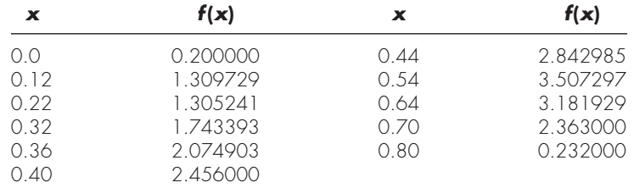
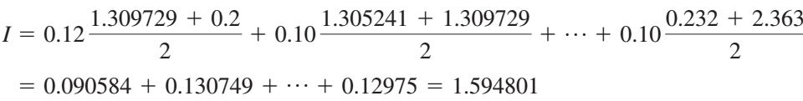

Integration with Unequal Segments
Integration scheme, if segement size is not equal.
Apply trapezoidal rule to each segment and sum the results:
Segment wise Trapezoidal Rule
Segment data:

Slide 21
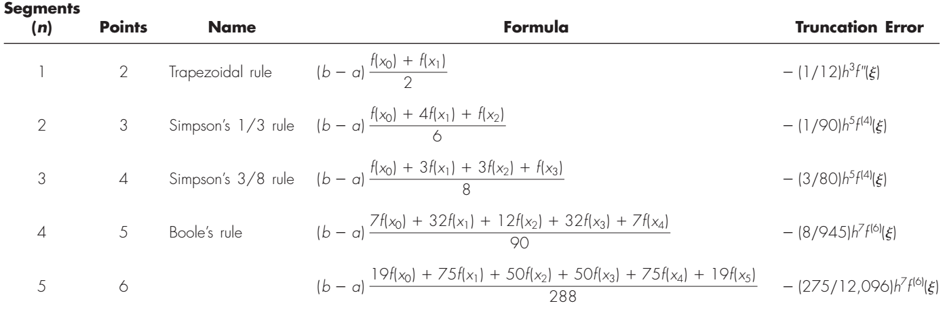
Newton-Cotes Integration

Slide 22
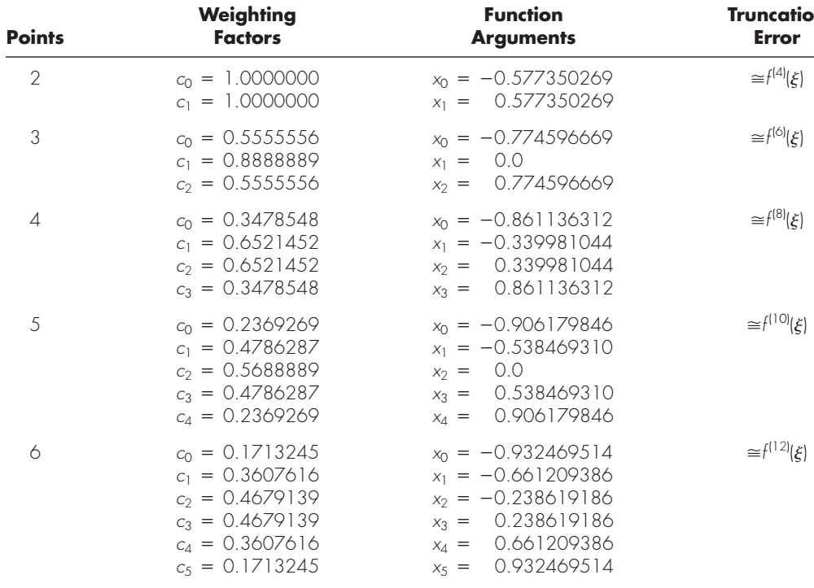

Gauss Quadrature
Weighted sum of function values at specified points within the domain of integration.
Gauss Quadrature Approximation (two points)
Gauss Quadrature Approximation (higher points)
Limit Conversion

Slide 23
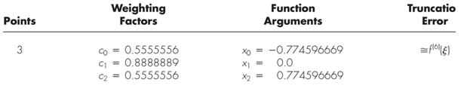
Gauss Quadrature
Example: Numerically integrate the following function:
Conversion of integration limit
Three point Gauss Quadrature

Slide 24
Gauss Quadrature

Slide 25
Gauss Quadrature
Gauss Point (n) | Integration Value (I) | Relative Error (ε)
1 | 1.036 | 15.89
2 | 0.9101 | 1.89
3 | 0.8942 | 0.03
4 | 0.8939 | 0

Slide 26


THANK YOU
Questions??

